Slide 1
Course Development and Instructional Design for Medical Simulation
Learn to create effective medical simulation courses
by William Morse, Ph.D.

Slide 2
Introduction to Medical Simulation
Overview
This course provides a comprehensive understanding of course development and instructional design principles specifically tailored for medical simulation. Participants will learn how to design and develop effective simulation-based learning experiences that enhance medical education and training. The course covers key topics such as needs assessment, learning objectives, scenario design, debriefing techniques, and evaluation methods.

Slide 3
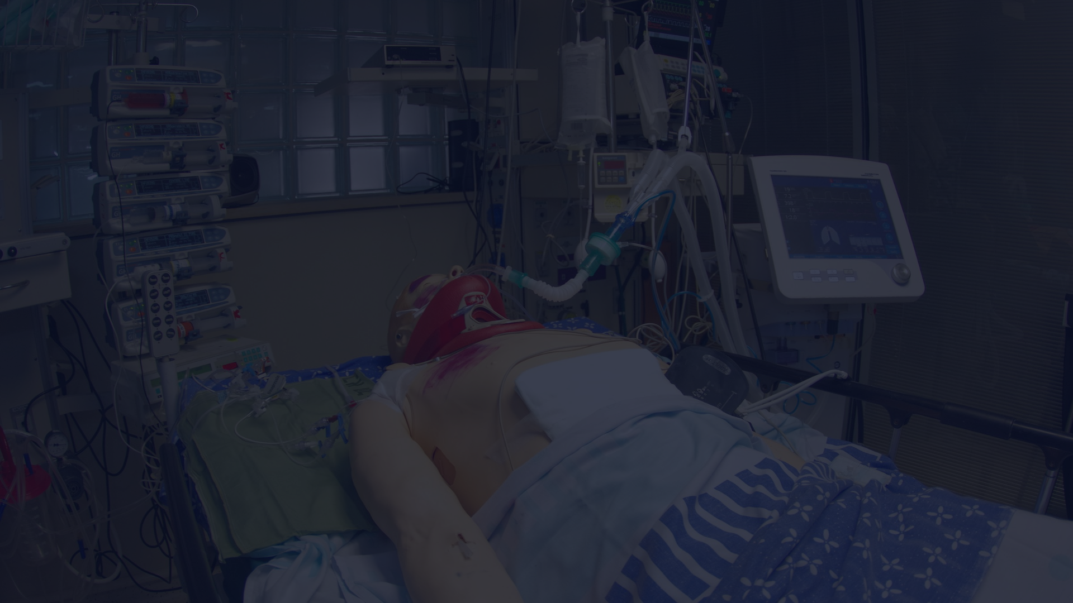
What is Medical Simulation?
Medical simulation is a teaching method that replicates real-life healthcare scenarios using lifelike models, virtual reality, and computer-based simulations. It is an educational technique often used in medical training to enhance clinical skills, decision-making abilities, and teamwork in a safe and controlled environment. By providing healthcare professionals with the opportunity to practice and refine their skills, medical simulation has become an invaluable tool in improving patient safety and quality of care.

Slide 4
The Purpose of Medical Simulation
Skill Development
Decision-Making Practice
Teamwork and Collaboration
Error Identification and Management

Slide 5
Improving Critical Thinking Skills through Simulation
Medical simulation presents learners with complex patient scenarios, challenging them to analyze and evaluate situations in a realistic environment. By practicing decision-making skills in a safe and controlled setting, healthcare professionals can enhance their ability to make sound clinical judgments.

Slide 6
Enhancing Clinical Proficiency through Simulation
Medical simulation allows healthcare professionals to develop and refine their clinical skills in a safe and controlled environment. By providing hands-on experience with various procedures, such as surgeries, medication administration, and emergency management, simulation can enhance learners' proficiency and confidence.

Slide 7
Fostering Collaboration and Communication through Simulation
Medical simulation provides opportunities for interdisciplinary collaboration, allowing healthcare professionals from different disciplines to work together and enhance their teamwork skills. By fostering communication, cooperation, and mutual understanding, simulation can improve patient outcomes and increase efficiencies in healthcare settings.

Slide 8
Reducing Medical Errors through Simulation
Simulation provides healthcare professionals with a safe environment to identify and manage errors. By practicing in a controlled setting, professionals can develop their skills and reduce the likelihood of errors in real patient care. This ultimately leads to better patient outcomes and improved safety in healthcare settings.

Slide 9
Benefits of Medical Simulation
Simulation Benefits
Enhanced learning experience
Safe environment for practice
Improved patient safety
Cost-effective training
Opportunities for research and evaluation
Medical simulation provides a realistic, safe, and cost-effective way for healthcare professionals to improve their skills, reduce medical errors, and ultimately enhance patient care.

Slide 10
Benefits of Medical Simulation
Teamwork and Collaboration
Medical simulation provides a unique opportunity for healthcare professionals to practice teamwork and collaboration in a high-stress, fast-paced environment. By working together to manage complex scenarios, teams can improve communication, coordination, and decision-making, leading to better patient outcomes and increased job satisfaction.

Slide 11
Benefits of Medical Simulation
Improved Patient Safety
Medical simulation enables healthcare professionals to practice complex procedures and scenarios in a controlled environment, leading to improved patient safety and better outcomes. By identifying and addressing potential errors and complications in a safe setting, healthcare professionals can provide more effective and efficient care to their patients.

Slide 12
Conclusion - Introduction to Medical Simulation
1
Enhanced Learning Experiences
2
Improved Patient Safety
Medical simulation enables healthcare professionals to practice and refine their skills in a safe and controlled environment.
By identifying and addressing potential errors and complications in a safe setting, healthcare professionals can provide more effective and efficient care to their patients.
3
Cost-Effective Training
4
Opportunities for Research and Evaluation
Medical simulation provides a cost-effective training method that can reduce the need for expensive equipment and minimize potential risks to patients.
Medical simulation offers opportunities for research and evaluation of new procedures and techniques, leading to more effective and efficient healthcare practices.
As instructional designers, understanding the fundamentals of medical simulation is essential for developing effective courses that empower healthcare professionals to deliver optimal patient care.

Slide 13
Designing Simulation Scenarios
Introduction
Simulation scenarios are an essential component of medical simulation training as they allow learners to apply their knowledge and skills in a realistic and dynamic environment. Designing effective simulation scenarios is crucial to ensure that learners achieve the desired learning outcomes and gain valuable hands-on experience in a safe setting. This topic will delve into the key considerations and best practices for designing simulation scenarios in medical education.

Slide 14
Scenario Development Process
Scenario Development Process
1
Assess Needs and Objectives
Conduct a needs assessment and define scenario objectives.
2
Storyboard and Develop Materials
Create a storyboard and develop supporting materials.
3
Design Simulation and Modalities
Design the simulation and select appropriate modalities.
4
Pilot Test and Refine
Pilot test the scenario and make necessary modifications.

Slide 15
Key Principles for Effective Scenario Design
Effective Scenario Design
1
Authenticity
2
Relevance
Make the scenario as realistic as possible.
Align the scenario with learners' objectives and clinical context.
3
Complexity
4
Variability
Gradually increase the challenge level of the scenario.
Introduce variability into the scenario to mimic real-life situations.
5
Interactivity
6
Feedback and Debriefing
Encourage active participation and interaction within the scenario.
Incorporate effective feedback and debriefing strategies into the scenario design.

Slide 16
Conclusion - Designing Simulation Scenarios
Designing simulation scenarios in medical education requires careful planning, collaboration, and adherence to key principles. By following a systematic development process and incorporating best practices, instructional designers can create immersive and effective scenarios that provide learners with valuable hands-on experience and an opportunity to develop essential clinical skills.

Slide 17
Effective Debriefing Techniques
Introduction
Debriefing is a crucial element in medical simulation as it allows learners to reflect on their performance, identify areas for improvement, and consolidate their learning. Effective debriefing techniques play a vital role in maximizing the educational benefits of medical simulation, leading to enhanced clinical competence and patient safety. In this section, we will explore various strategies and approaches for conducting effective debriefing sessions in medical simulation.

Slide 18
The Importance of Debriefing
Debriefing serves as the backbone of the simulation experience, providing learners with an opportunity to reflect on their actions, analyze their decision-making processes, and gain valuable insights into their performance. It enables learners to bridge the gap between theory and practice, allowing for the transfer of knowledge and skills from the simulated environment to real-life clinical settings.

Slide 19
Key Principles of Effective Debriefing
Effective Debriefing Principles
Psychological Safety
Structured Approach
Establish a non-punitive, open environment for discussion.
Use established models to guide the discussion in a logical manner.
Active Facilitation
Reflection
Engage participants, encourage reflection, and guide discussion.
Promote reflection to identify knowledge gaps and challenge assumptions.
Feedback
Application to Practice
Provide constructive feedback tailored to individual needs.
Connect simulation experience to real-life clinical practice.

Slide 20
Variations in Debriefing Techniques
Debriefing Techniques
1
Directive
2
Facilitative
Facilitator provides explicit guidance and direction to learners.
Facilitator acts as a guide, encouraging learners to explore their own experiences.
3
Group
4
Individual
Multiple learners participate in the debriefing session simultaneously.
One-on-one sessions between the learner and the facilitator for more personalized feedback.

Slide 21
Conclusion - Effective Debriefing Techniques
Key Points
1
Create a safe environment
2
Structure the session
Establish psychological safety for learners
Follow a structured debriefing approach
3
Encourage reflection
4
Provide feedback
Encourage learners to reflect on their experiences
Offer constructive feedback to help learners improve
5
Apply learning
6
Vary the techniques
Help learners apply their new knowledge to real-life practice
Adapt debriefing techniques to meet learners' needs and preferences

Slide 22
Review of Course
Key Takeaways
Key Points
1
Benefits of medical simulation:
2
Designing simulation scenarios:
Enhanced learning experiences, improved patient safety, cost-effective training, and opportunities for research and evaluation.
Requires careful planning, collaboration, and adherence to key principles.
3
Effective debriefing techniques:
Create a psychologically safe environment, employ a structured approach, encourage reflection, provide constructive feedback, and facilitate application of learning to real-life practice. Utilize variations in debriefing techniques to meet the unique needs and preferences of learners.

