Slide 1
Root Cause Analysis in Quality Improvement in Healthcare
Improve healthcare quality by identifying and addressing root causes of problems
by William Morse. Ph.D.

Slide 2
Overview
This course provides a comprehensive understanding of root cause analysis (RCA) in quality improvement within the healthcare sector. Participants will learn essential concepts and tools for identifying, analyzing, and addressing the underlying causes of issues and errors in healthcare processes. The course emphasizes the importance of RCA in improving patient safety, reducing medical errors, and enhancing overall healthcare quality.

Slide 3
Educational Objectives
1. Conduct a Root Cause Analysis
2. Utilize RCA Tools
3. Implement Corrective Actions
Participants should be able to independently conduct a root cause analysis on a simulated healthcare issue, identifying at least one root cause and two contributing factors, within a week of completing the course.
Participants should be proficient in using at least three different root cause analysis tools (e.g., Fishbone Diagram, Five Whys, Pareto Analysis) to analyze a given healthcare problem, demonstrating their skills in a hands-on exercise within two weeks of course completion.
After identifying root causes, participants should be able to develop and present a SMART action plan for implementing corrective actions, including timelines and responsible parties, and monitor the plan's effectiveness over a one-month period post-course.

Slide 4
Course Outline Summary
Module 1: Introduction to Root Cause Analysis
Module 2: Methods and Tools for Root Cause Analysis
Module 3: Implementing Effective Solutions
The Five Whys
Key Considerations for Solution Implementation
What is Root Cause Analysis?
Fishbone Diagram (Ishikawa Diagram)
Strategies for Solution Implementation
The Importance of RCA in Healthcare
Flowcharts
Pareto Analysis
Key Steps in RCA
Failure Mode and Effects Analysis (FMEA)
Statistical Analysis
Failure Analysis

Slide 5
Module 1: Introduction to Root Cause Analysis
1
What is Root Cause Analysis?
2
The Importance of RCA in Healthcare
3
Key Steps in RCA
Defining the problem, gathering data, identifying immediate and contributing factors, determining root causes, developing corrective actions, and monitoring.
Root Cause Analysis (RCA) is a systematic approach used to identify the underlying causes of problems or incidents in various industries, including healthcare.
RCA plays a crucial role in identifying the root causes of medical errors, adverse events, and other quality issues in healthcare.

Slide 6
Module 2: Methods and Tools for Root Cause Analysis
1
The Five Whys
2
Fishbone Diagram (Ishikawa Diagram)
3
Flowcharts
A simple questioning technique for identifying root causes by asking "why" repeatedly.
Graphical representation of processes to identify critical steps or decision points.
A visual tool for categorizing potential causes into branches representing different categories.
4
Pareto Analysis
5
Failure Mode and Effects Analysis (FMEA)
6
Statistical Analysis
Technique for prioritizing the most significant causes based on the 80/20 rule.
Quantitative methods for identifying patterns and trends in data.
Proactive technique for identifying and mitigating potential failures within a system, process, or product.
7
Failure Analysis
Investigative techniques for understanding the reasons behind failures of components, systems, or processes.

Slide 7
Module 3: Implementing Effective Solutions
1
Key Considerations for Solution Implementation
Collaborative approach, clear goals, action planning, leadership support, and continuous evaluation.
2
Strategies for Solution Implementation
Stakeholder engagement, education and training, pilot testing, transparent communication, sustainability planning, and celebrating success.

Slide 8
What is Root Cause Analysis?
Root Cause Analysis (RCA) is a systematic approach used to identify the underlying causes of problems or incidents in various industries, including healthcare. In the context of quality improvement in healthcare, RCA plays a crucial role in identifying the root causes of medical errors, adverse events, and other quality issues. By addressing these root causes, healthcare organizations can make necessary changes to prevent similar incidents from occurring in the future.

Slide 9
The Importance of Root Cause Analysis in Healthcare
Root Cause Analysis is an essential tool in healthcare quality improvement for several reasons:
1
Identifying system weaknesses
2
Preventing recurrence
3
Continuous learning and improvement
RCA helps in uncovering system weaknesses, vulnerabilities, and failures that contribute to adverse events. It allows healthcare institutions to address underlying issues affecting patient safety and quality of care.
By identifying and addressing root causes, RCA prevents the recurrence of similar incidents in the future. This leads to a reduction in patient harm, improved patient outcomes, and a safer healthcare environment.
RCA encourages a culture of continuous learning and improvement within healthcare organizations. It promotes open communication, collaboration, and proactive problem-solving.

Slide 10
1
Define the problem
2
Gather data and evidence
3
Identify immediate causes
Gather details about the incident.
Collect all relevant data.
Identify the factors directly involved.
4
Identify contributing factors
5
Determine root causes
6
Develop corrective actions
Find the underlying issues.
Create a plan to prevent recurrence.
Analyze the broader context.
7
Implement and monitor
Put the plan into action and evaluate progress.

Slide 11
Conclusion: Introduction to Root Cause Analysis
The Introduction to Root Cause Analysis module has provided a solid foundation for understanding the importance of identifying underlying causes of problems in healthcare. With the knowledge gained about key concepts and principles of root cause analysis, participants can now initiate quality improvement initiatives with a systematic approach.

Slide 12
Methods and Tools for Root Cause Analysis
Root Cause Analysis (RCA) is a systematic approach to identifying underlying reasons and contributing factors that lead to medical errors, adverse events, or near misses. Effective RCA involves various methods and tools. In this section, we explore some of the most commonly employed methods and tools for RCA in quality improvement in healthcare.

Slide 13
Methods and Tools for RCA
The Five Whys
Fishbone Diagram
Flowcharts
A simple questioning technique for identifying root causes by repeatedly asking "why."
A visual tool for categorizing potential causes into different categories.
Graphical representations of processes to identify critical steps or decision points.
Pareto Analysis
Failure Mode and Effects Analysis (FMEA)
Statistical Analysis
A technique for prioritizing the most significant causes based on the 80/20 rule.
Quantitative methods for identifying patterns and trends in data.
A proactive technique for identifying and mitigating potential failures within a system, process, or product.
Failure Analysis
Investigative techniques for understanding the reasons behind failures of components, systems, or processes.

Slide 14
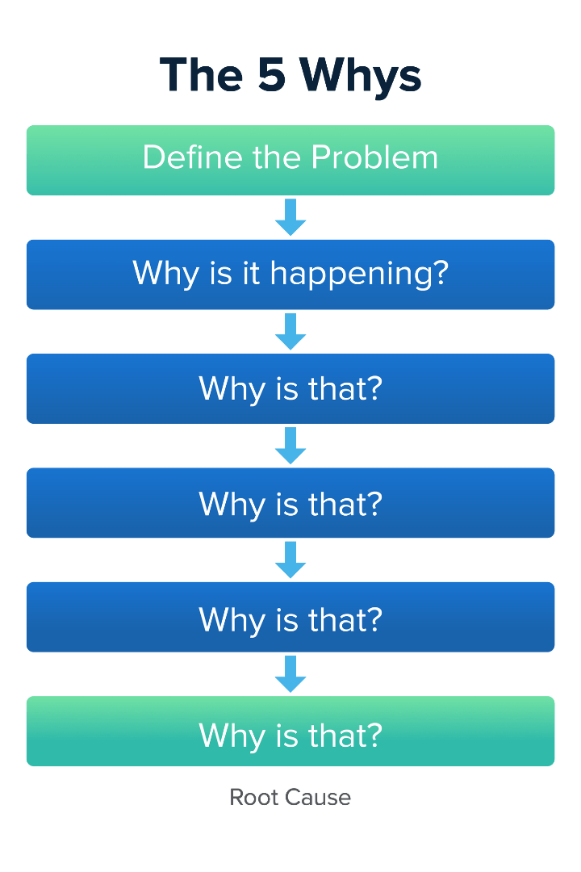
The Five Whys: A Simple Yet Powerful RCA Method
The Five Whys is a questioning technique used to identify root causes of incidents. It involves repeatedly asking "why" to delve deeper into the causal factors behind an event. By peeling away the layers of causes and effects, investigators can identify the root cause and take action to prevent recurrence.

Slide 15
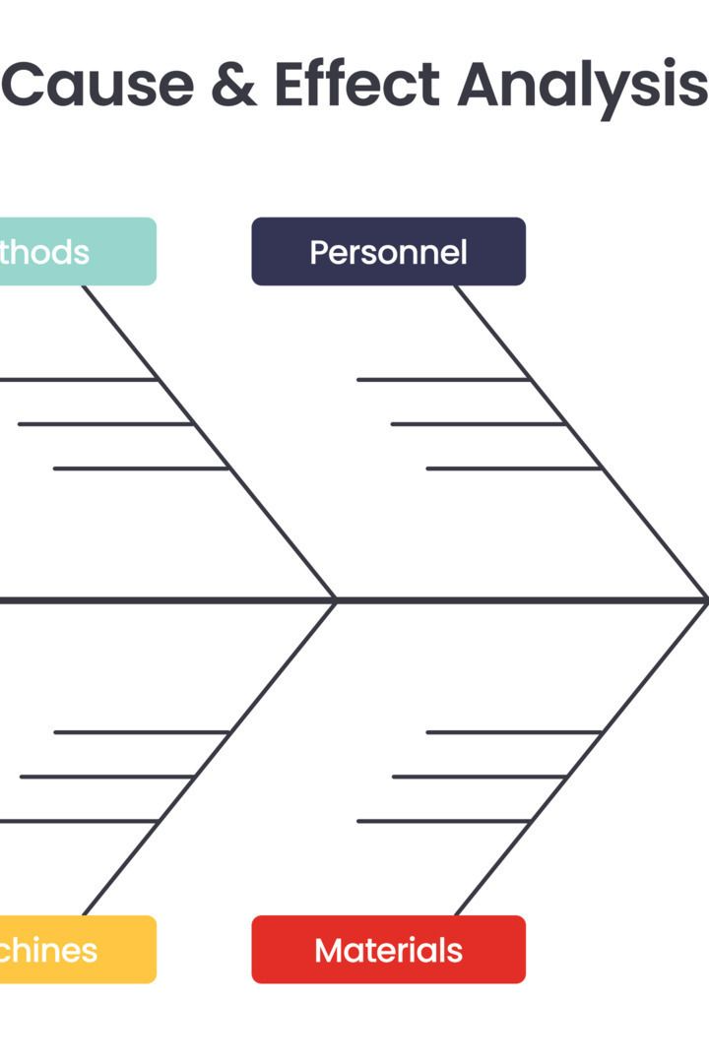
The Fishbone Diagram: A Visual Tool for Root Cause Analysis
The Fishbone Diagram, also known as the Ishikawa Diagram or Cause and Effect Diagram, is a powerful visual tool for analyzing the potential causes of an event or problem. By identifying and categorizing different types of causes, such as equipment, process, people, materials, or environment, investigators can conduct a comprehensive analysis to identify the root cause and take action to prevent recurrence.

Slide 16
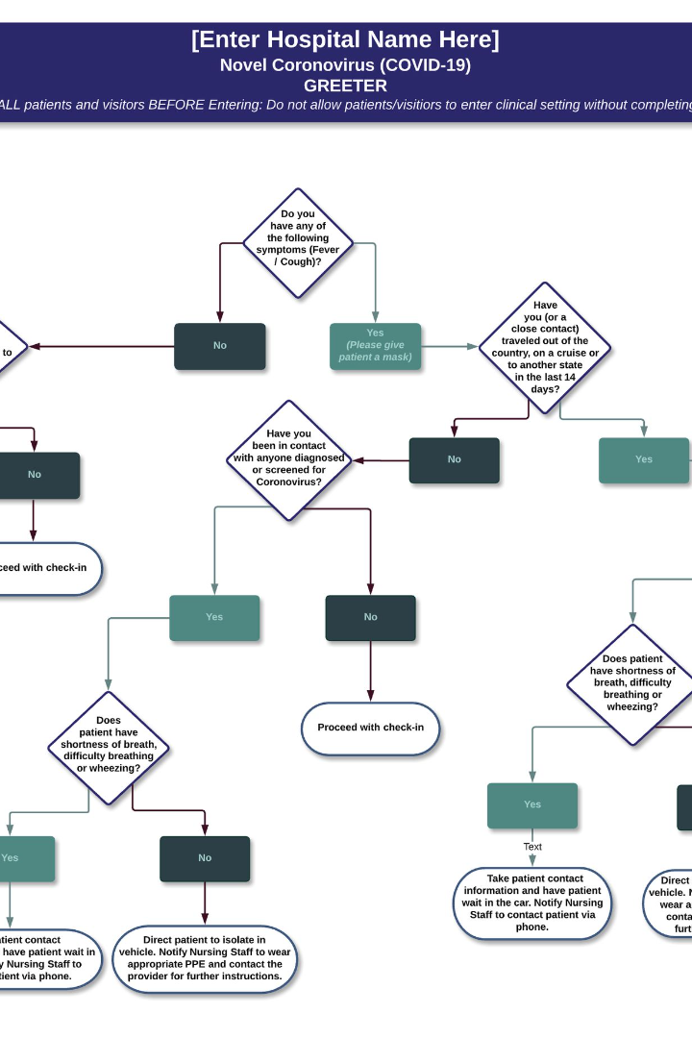
Flowcharts: A Visual Representation of the Process
Flowcharts are graphical representations that display a step-by-step sequence of activities or a process. They can help investigators visualize the timeline and identify critical steps or decision points, revealing whether there were any deviations from the standard process, potential bottlenecks, or gaps in communication that contributed to the incident.

Slide 17
Pareto Analysis: Prioritizing the Vital Few Causes
Also known as the 80/20 rule, Pareto Analysis assists in identifying and prioritizing the most significant causes contributing to an issue. By categorizing and quantifying different causes, investigators can identify the vital few causes that should be addressed in order to achieve the greatest improvement.

Slide 18
Failure Mode and Effects Analysis (FMEA)
Failure Mode and Effects Analysis is a proactive technique used to identify and mitigate potential failure modes within a system, process, or product. While not directly focused on root cause analysis, FMEA is complementary to RCA as the identification and prevention of potential failures can help avoid future incidents. FMEA involves systematically analyzing each component or step, assessing its potential failure modes, determining its impact, and prioritizing preventive actions based on severity and likelihood.

Slide 19
Statistical Analysis: Uncover Patterns and Trends to Identify Root Causes
Statistical analysis is a quantitative approach to root cause analysis. Various techniques can be employed to explore relationships and identify significant factors contributing to the incident. By utilizing statistical methods, investigators can uncover patterns, trends, and associations in data to draw evidence-based conclusions and provide insights into the root causes of the problem.

Slide 20
Failure Analysis: Investigating Root Causes of Failed Components, Systems, or Processes
Failure analysis involves examining physical evidence, conducting laboratory testing, or utilizing experts to identify the root cause of the failure. This comprehensive investigation can help investigators understand the underlying reasons behind an incident and implement appropriate corrective and preventive actions.

Slide 21
Conclusion - Methods and Tools for Root Cause Analysis
The Methods and Tools for Root Cause Analysis module equips participants with diverse techniques and tools to uncover and analyze root causes effectively. By exploring methods such as fishbone diagrams, Pareto charts, and Five Whys analysis, participants develop the skills to conduct in-depth investigations and make informed decisions based on data-driven insights.

Slide 22
Implementing Effective Solutions
1
Key Considerations for Solution Implementation
Collaborative approach, clear goals, action planning, leadership support, and continuous evaluation.
2
Strategies for Solution Implementation
Stakeholder engagement, education and training, pilot testing, transparent communication, sustainability planning, and celebrating success.

Slide 23
Key Considerations for Solution Implementation
1
Collaborative Approach
2
Clear Goals and Objectives
3
Action Planning
Create a detailed action plan with tasks, timelines, and resources.
Collaboration of interdisciplinary teams is key for successful implementation.
Establish specific, measurable, achievable, relevant, and time-bound (SMART) goals.
4
Leadership Support
5
Continuous Evaluation
Secure support from organizational leadership for decision-making and guidance.
Regularly evaluate and monitor progress and impact using qualitative and quantitative measures.

Slide 24
Strategies for Solution Implementation
1
Stakeholder Engagement
2
Education and Training
3
Pilot Testing
Conduct pilot tests in a small-scale setting to assess the feasibility and effectiveness of the proposed solutions before widespread implementation.
Engage all relevant stakeholders throughout the implementation process to ensure their perspectives are considered and a patient-centered approach is maintained.
Provide comprehensive education and training to individuals impacted by the change to ensure successful adoption of the implemented solutions.
4
Transparent Communication
5
Sustainability Planning
Maintain transparent communication channels, providing regular updates to stakeholders, addressing concerns promptly, and encouraging feedback.
Develop a comprehensive sustainability plan to ensure the long-term success and integration of the implemented solutions into existing quality improvement processes.

Slide 25
Review of Course
1
Key Takeaways
2
Methods and Tools
3
Implementing Effective Solutions
The Introduction to Root Cause Analysis module has provided a solid foundation for understanding the importance of identifying underlying causes of problems in healthcare.
The Methods and Tools for Root Cause Analysis module has equipped participants with a diverse set of techniques and tools to uncover and analyze root causes effectively.
The Implementing Effective Solutions module has prepared participants to develop comprehensive solution plans and facilitate successful quality improvement initiatives.

